Slide 1

SQL PRESENTATION
SQL
Title:
Introduction to SQL
Subtitle:
Structured Query Language
By BHANU

Slide 2
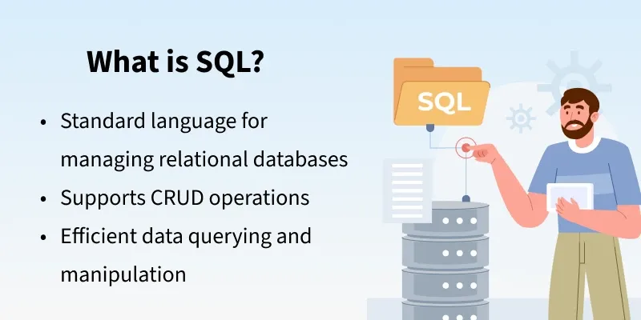
It is used to store, retrieve, update, and delete data.
SQL works with Relational Database Management Systems (RDBMS).
Examples of RDBMS:
MySQL
Oracle Database
Microsoft SQL Server
PostgreSQL

Slide 3
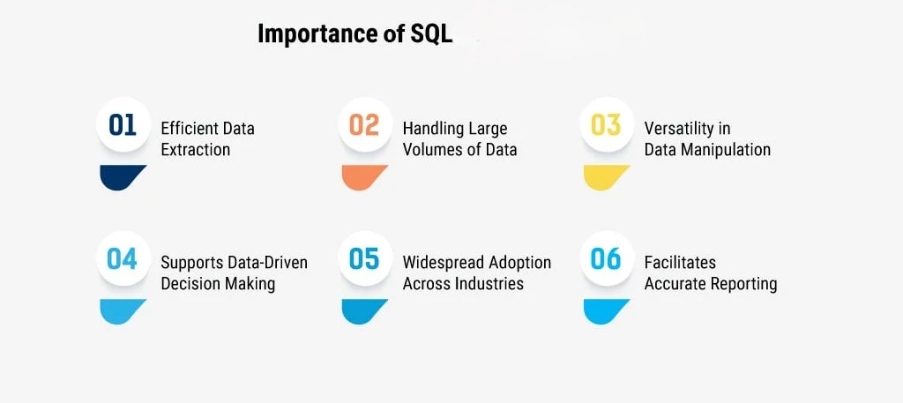
Why is SQL Important?
Handles large amounts of data efficiently
Helps in Data Analysis & Decision Making
Essential for High-Demand Careers
Use in almost every industry

Slide 4
What is a Database?
A database is an organized collection of data
Stores information in tables
Student records
Employee data
Product inventory
Examples:
What is a DBMS?
DBMS = Database Management System
Software that manages databases

Slide 5
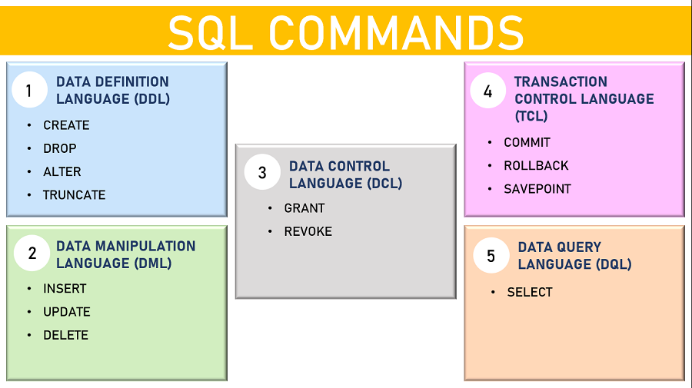

Slide 6
DDL Commands
Used to define database structure
CREATE – Create database or table
ALTER – Modify structure
DROP – Delete database or table
TRUNCATE – Remove all records
Example:
CREATE TABLE Students ( ID INT, Name VARCHAR(50), Age INT );

Slide 7
DML Commands
Used to manage data
Example:
INSERT – Add data
UPDATE – Modify data
DELETE – Remove data
INSERT INTO Students VALUES (1, 'John', 20);
DQL Command
SELECT – Retrieve data from database
Example:
SELECT * FROM Students;
DCL Commands
Used for permissions
GRANT – Give access
REVOKE – Remove access

Slide 8
TCL Commands
Used for transaction management
ROLLBACK – Undo changes
COMMIT – Save changes
SAVEPOINT – Set save point
ROLLBACK – Undo changes
SAVEPOINT – Set save point
DELETE FROM Students WHERE ID = 101;
ROLLBACK;
INSERT INTO Students VALUES (102,'Neha',21);
SAVEPOINT A;
INSERT INTO Students VALUES (103,'Aman',22);
ROLLBACK TO A;
COMMIT – Save changes
INSERT INTO Students VALUES (101,'Rahul',20);
COMMIT;

Slide 9
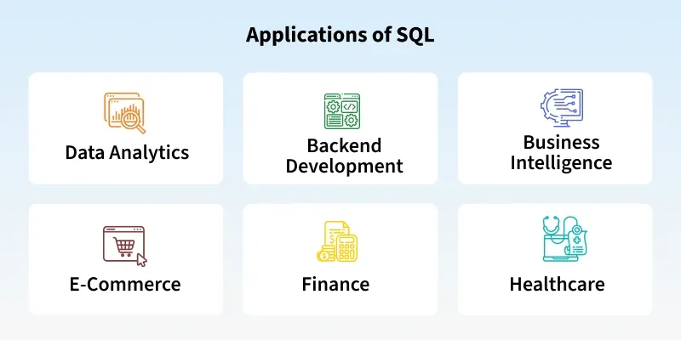
Why Learn SQL?
High demand skill in IT industry
Required for Data Analysis
Used in Web Development
Essential for Backend Development
Banking systems
E-commerce websites
School/University databases
Healthcare systems

Slide 10
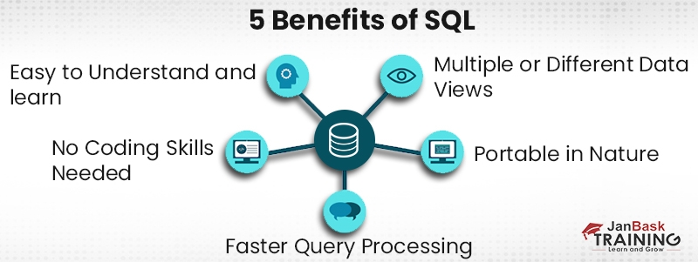
Advantages of SQL
Fast data retrieval
Easy data manipulation
Standard language across platforms
Secure and reliable
Conclusion
SQL is essential for working with databases
Used worldwide across industries
Foundation for data-related careers

Slide 11
How to Download MySQL
Open your browser.
Visit the official MySQL website
https://dev.mysql.com/downloads/installer/
Download MySQL Installer for Windows.
Choose MYSQL-installer-community (the free version).
Run the Installer
Double-click the downloaded file.
Click Yes if Windows asks for permission.
Choose Developer Default (recommended for beginners).
This installs:
MySQL Server
MySQL Workbench (GUI to write SQL queries)
Other required tools

Slide 12
Configure MySQL Server
Choose Standalone MySQL Server.
Keep the default port 3306.
Select Strong Password Encryption.
Set a root password (remember it).
Example:
Username: root
Password: your _ password

Slide 13
Finish Installation
Click Execute to install components.
Click Finish when done.
Open MySQL
Open MySQL Workbench from the Start Menu.
Click Local instance MySQL80.
Enter your root password.
Example:
SELECT * FROM database _ name. table _ name;

Slide 14
THANK YOU

